Slide 1
Optical coherence tomography angiography with neural network
Kensuke Oikawa

Slide 2
Overview
Summary of OCT angiography
Paper1:Generating retinal flow maps from structural optical coherence tomography with artificial intelligence
Paper2:Deep learning algorithm for generating optical coherence tomography angiography (OCTA) maps of the retinal vasculature
Notes:
Last time Praew explained about classification, semantic segmentation and denoising in OCT image processing.

Slide 3
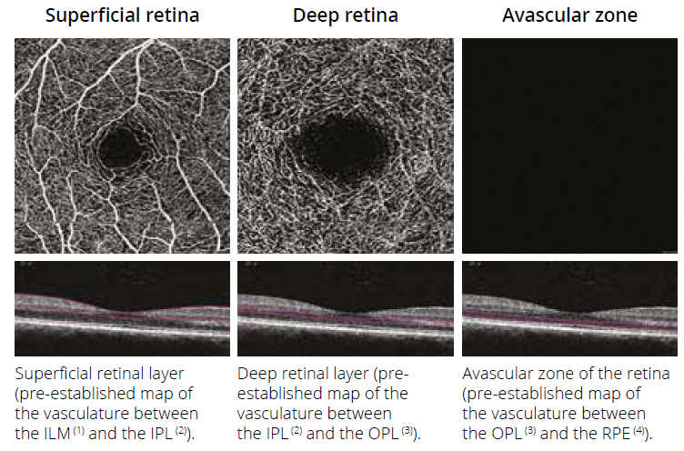
OCT angiography
OCTA is a technique to visualize microvasculature.
Compared to other technique,
Noninvasive (w/o need of contrast agent)
3D acquisition

Slide 4
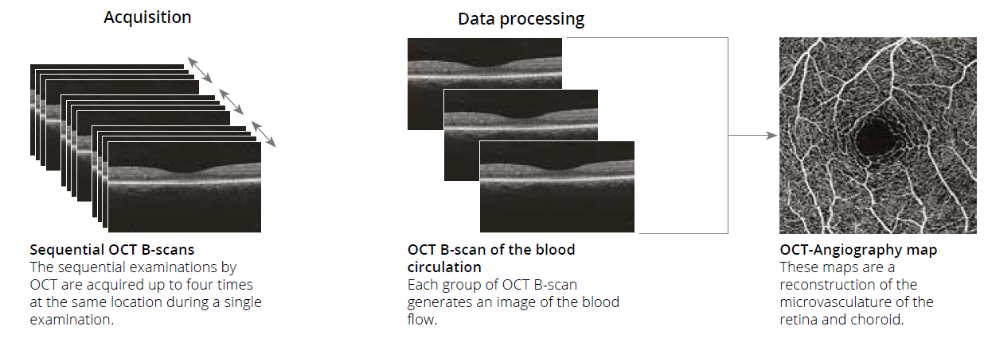
OCT angiography
OCTA en-face is reconstructed from the following process.
Multiple B-scans are captured at the same location.
Blood flow images are generated from the B-scans. (OMAG, SSAPGA etc)
En-face image is reconstructed.

Slide 5
OCTA requirements
OCTA requires high-speed scanning OCT system to avoid the eye movement.
Also, OCTA requires longer scanning time than normal OCT does.
These two requirements come from the multiple scanning.
→ OCTA reconstruction from smaller number of B-scan has significant.

Slide 6
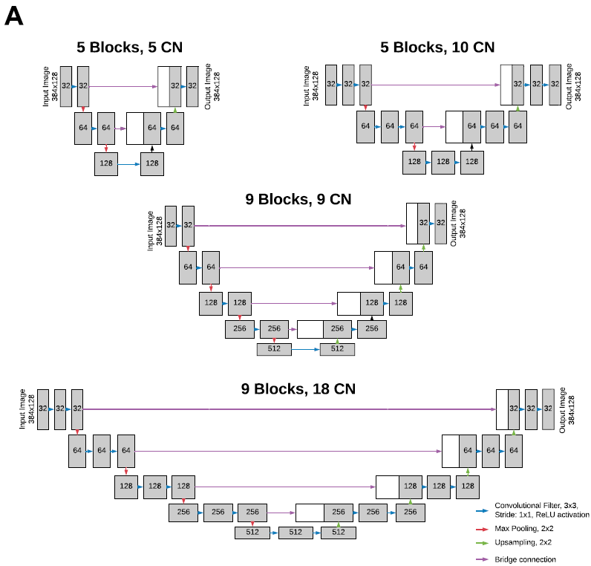
OCTA from one B-scan with U-net
Lee, C. S., Tyring, A. J., Wu, Y., Xiao, S., Rokem, A. S., DeRuyter, N. P., Zhang, Q., Tufail, A., Wang, R. K., & Lee, A. Y. (2019). Generating retinal flow maps from structural optical coherence tomography with artificial intelligence. Scientific Reports, 9(1), 5694.
Input: One B-scan (384 px by 128 px)
Ground truth: OCTA taken by 68 kHz CIRRUS™ HD-OCT 5000 with AngioPlex™ OCT Angiography (ZEISS, Dublin, CA)
Model: Autoencoder net (no skip connection), U-shaped net with element-wise sum and with copy and concatenate at various depth. (Totally 12 models were examined.)

Slide 7
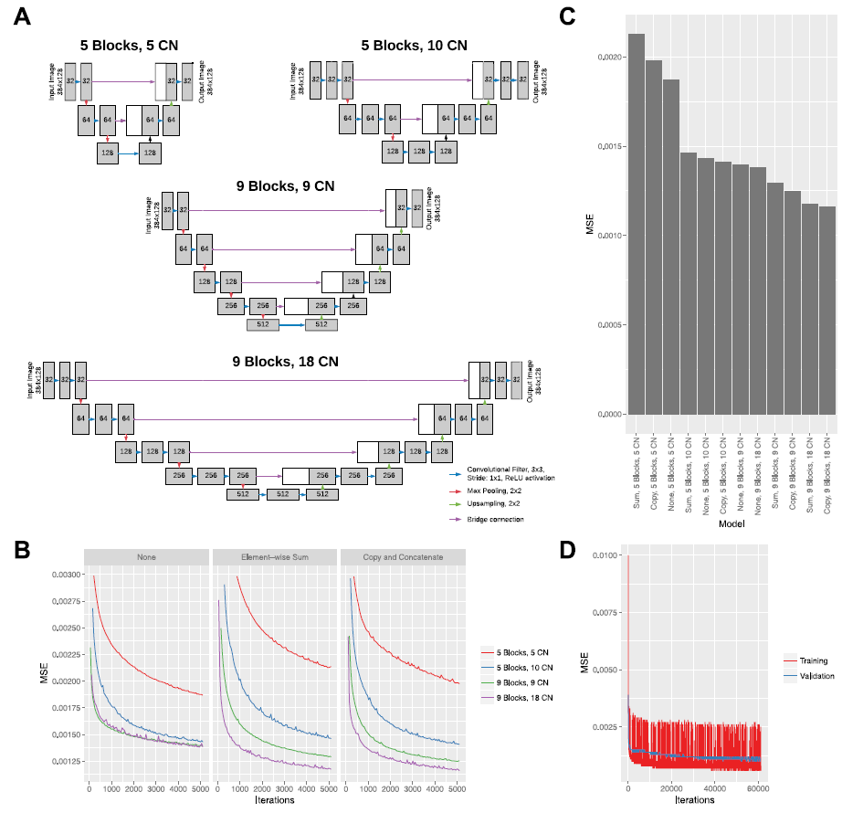
OCTA from one B-scan with U-net
U-shaped nets (with skip connections) have smaller MSE.
The models having more blocks and CN show smaller MSE.
There is not significant difference between element-wise sum and copy and concatenate in bridge connection.
Notes:
Schematics of deep learning model architectures tested by varying block depth and number of convolutional (CN) filters (A). Learning curve for all models with Mean Standard Error (MSE) for validation sets with the same batch size and learning rate and faceted by bridge type (B). Lowest MSE after 5,000 iterations for all models (C). Learning curves for the best performing (9 blocks, 18 convolutional filters, copy and concatenation bridge) on training and validation set for an extended training session (D).

Slide 8
OCTA from one B-scan with U-net
OCT
OCTA
Model
Notes:
Schematics of deep learning model architectures tested by varying block depth and number of convolutional (CN) filters (A). Learning curve for all models with Mean Standard Error (MSE) for validation sets with the same batch size and learning rate and faceted by bridge type (B). Lowest MSE after 5,000 iterations for all models (C). Learning curves for the best performing (9 blocks, 18 convolutional filters, copy and concatenation bridge) on training and validation set for an extended training session (D).

Slide 9
OCTA from one B-scan with U-net
OCT
Model
OCTA
Model
OCTA
The model visualize not only the vasculature which can be seen in OCT B-scan, but also some microvasculature.
Notes:
Schematics of deep learning model architectures tested by varying block depth and number of convolutional (CN) filters (A). Learning curve for all models with Mean Standard Error (MSE) for validation sets with the same batch size and learning rate and faceted by bridge type (B). Lowest MSE after 5,000 iterations for all models (C). Learning curves for the best performing (9 blocks, 18 convolutional filters, copy and concatenation bridge) on training and validation set for an extended training session (D).

Slide 10
OCTA from one B-scan with U-net
Discussion: Why could the model estimate a flow map from one B-scan?
Speckle information would be used.
If the sample is static, speckle pattern is fixed. However, when there is localized blood flow, the speckle pattern at that position will tend to become finer.
Notes:
One of the potential explanations by which deep learning infers flow from static images relate to speckle formation from the optical system19,20. The OCT uses coherent light source, therefore, speckle formation is inevitable from the optical interference due to heterogeneous properties of biological tissue. In fact, OCT imaging system is a combination of numerous laser speckle imaging systems. If the tissue target is static, then the speckle pattern in the OCT image is fixed and determined by optical system setup (numerical aperture, wavelength used, etc) and the size of scatters. However, when there is localized blood flow within tissue, the speckle pattern at that localized position will tend to become finer. The faster the speed of the flow, the finer the speckle pattern would appear in the static optical image that is captured. Therefore, the statistical properties of localized spatial speckle pattern (for example variance) would be a good surrogate to infer the dynamic information from the static optical images.

Slide 11
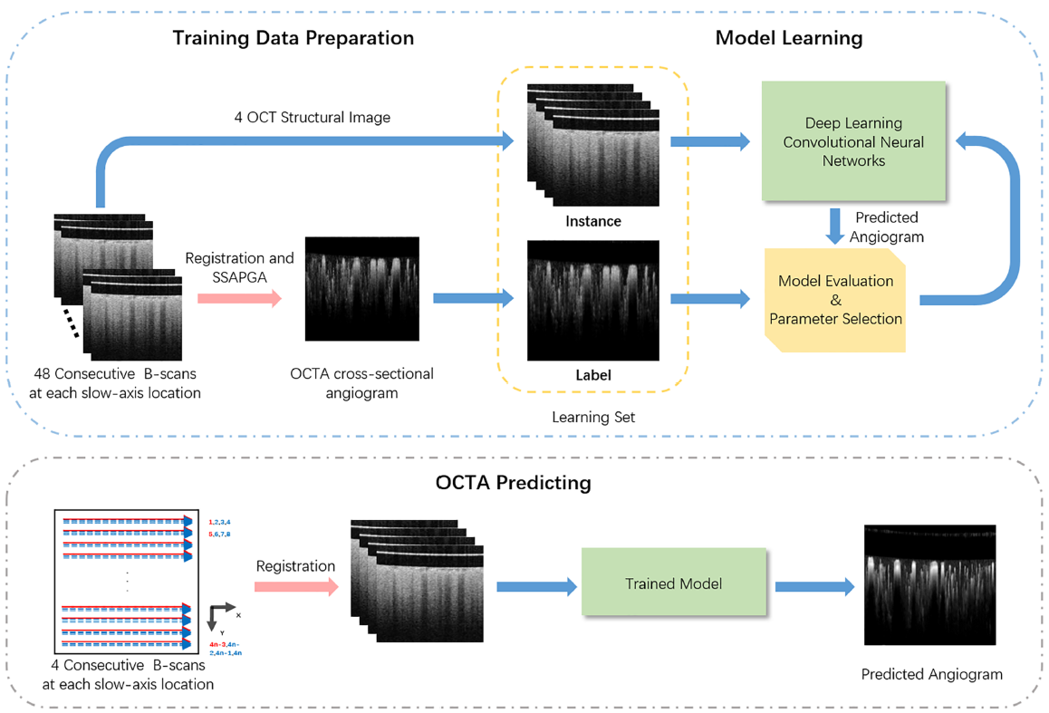
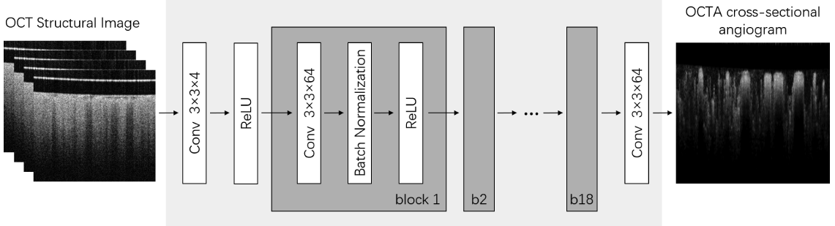
SNR enhancement for OCTA
Liu, X., Huang, Z., Wang, Z., Wen, C., Jiang, Z., Yu, Z., Liu, J., Liu, G., Huang, X., Maier, A., Ren, Q., & Lu, Y. (2019). A deep learning based pipeline for optical coherence tomography angiography. Journal of Biophotonics, 12(10), e201900008.
The number of repeated B-scans has a great impact on OCT angiography SNR [1].
Input: 4 B-scans taken at the same location (40 px by 40 px)
Ground truth: OCTA reconstructed from 48 split-spectrum amplitude and phase-gradient angiography (SSAPGA) algorithm
Model: Autoencoder
[1]A. Mariampillai, M. K. Leung, M. Jarvi, B. A. Standish, K. Lee, B. C. Wilson, A. Vitkin, V. X. Yang, Opt. Lett. 2010, 35, 1257.

Slide 12
SNR enhancement for OCTA
Comparison of OCTA image among SSAPGA(ground truth) and other OCTA techniques
four consecutive B-scans using SSAPGA, convolutional neural network(CNN), power intensity differential(PID) and correlation mapping(CM) respectively.

Slide 13
SNR enhancement for OCTA
Comparison of OCTA image among SSAPGA(ground truth) and other OCTA techniques with lower number of input images.
Discussion: This technique uses the speckle not only to reconstruct OCTA, but also to remove background noise induced by OCTA
imaging systems

Slide 14
Summary
I introduced two papers of OCTA techniques with neural network.
This field is still developing, and they have a plenty room for developing, such as model modification and how to input the data.

Slide 15
OCT angiography
クリックしてマスター テキストのスタイルを編集する
第 2 レベル
第 3 レベル
第 4 レベル
第 5 レベル

Slide 16
OCTA requirements
OCTA is a technique to visualize microvasculature.
Compared to other technique,
Noninvasive (without the need of contract agent)
3D acquisition

